Slide 1









G
o
Inner
o
se
s
'
World
◆ Yiyuan Qin

Slide 2
Intro
CONTENTS
Perform
Code
Q&A

Slide 3
I felt a Funeral, in my Brain,
And Mourners to and fro
Kept treading - treading - till it seemed
That Sense was breaking through -
And when they all were seated,
A Service, like a Drum -
Kept beating - beating - till I thought
My mind was going numb -
And then I heard them lift a Box
And creak across my Soul
With those same Boots of Lead, again,
Then Space - began to toll,
As all the Heavens were a Bell,
And Being, but an Ear,
And I, and Silence, some strange Race,
Wrecked, solitary, here -
And then a Plank in Reason, broke,
And I dropped down, and down -
And hit a World, at every plunge,
And Finished knowing - then -
BY EMILY DICKINSON
I
dea
我的脑海中，进行着一场葬礼
悼念者络绎不绝，不停地走着、踩踏着
直到仪式的氛围渐浓
当所有人入座，仪式开始;
敲鼓的声音沉重有力，敲打着，敲打着，敲打着
直到我的意识变得麻木
我听见他们抬起棺材，沉重的脚步，摇摇晃晃；
我的灵魂，吱呀作响
四周，丧钟响起；
天堂，就像一个铃铛；
存在，仅剩下一只耳朵。
安静如我，如同异类，在此孤独，在此腐朽
失去依靠，理性开始崩塌，
我从高处坠落，跌入一个又一个世界……

Slide 4
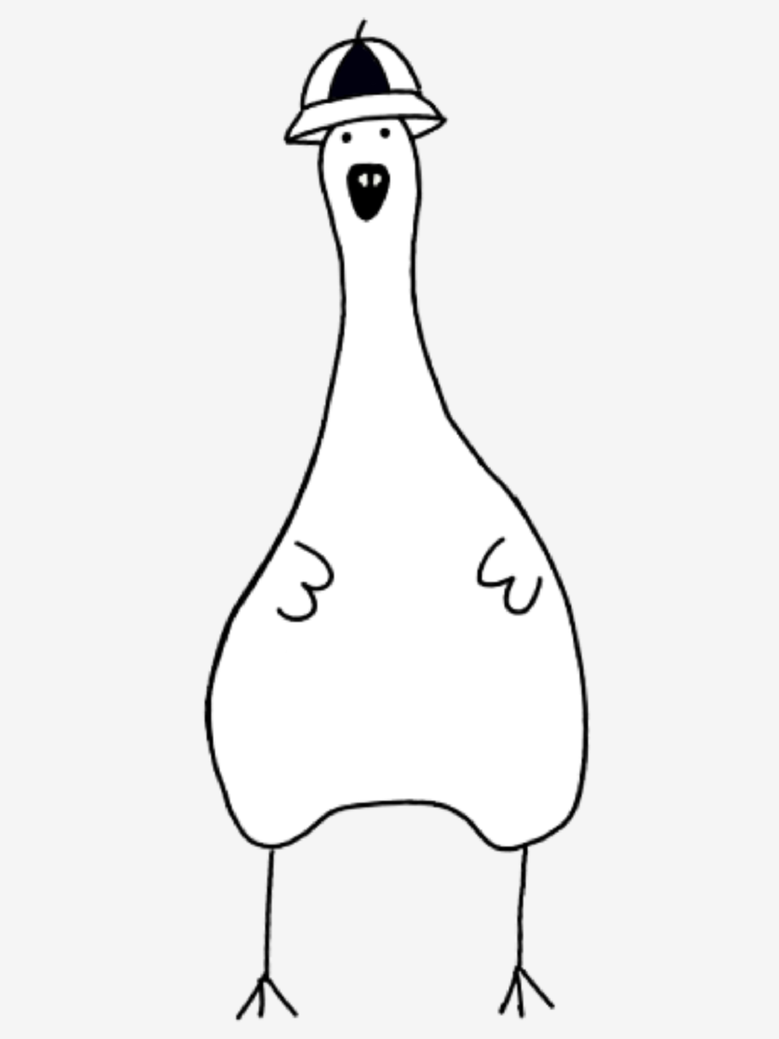
C
oncepts
Name: Goose
Age: No recorder
Symptom: Depression
Tel: xxx

Slide 5
particle system
drawsubsection
shader
elastic force
map
...
C
ode
1. Class of some animation
background music
reciting
drum
pace
morning
...
2. Sounds
Structure: scene 0 to 7
3. Lines
draw lines in each scene
mouseclick
key-up/down/left/right/space
key-abcdeg
mousedrag
4. Interactive emotion

Slide 6
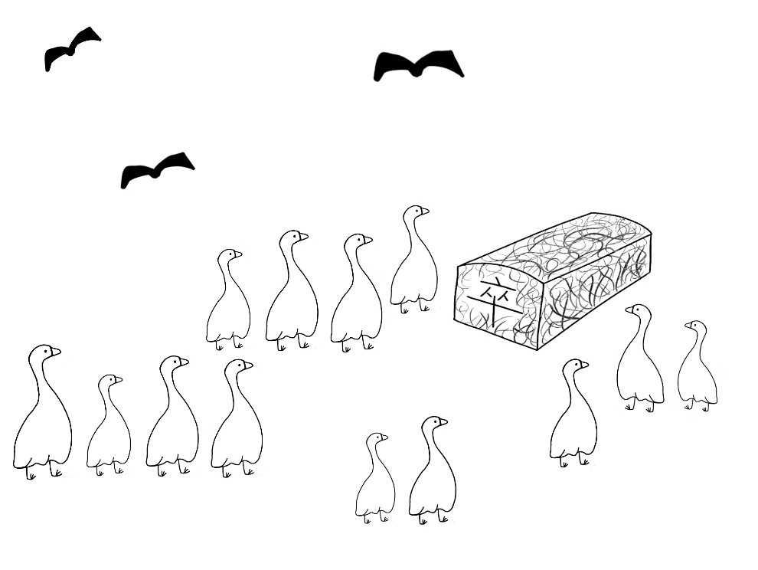
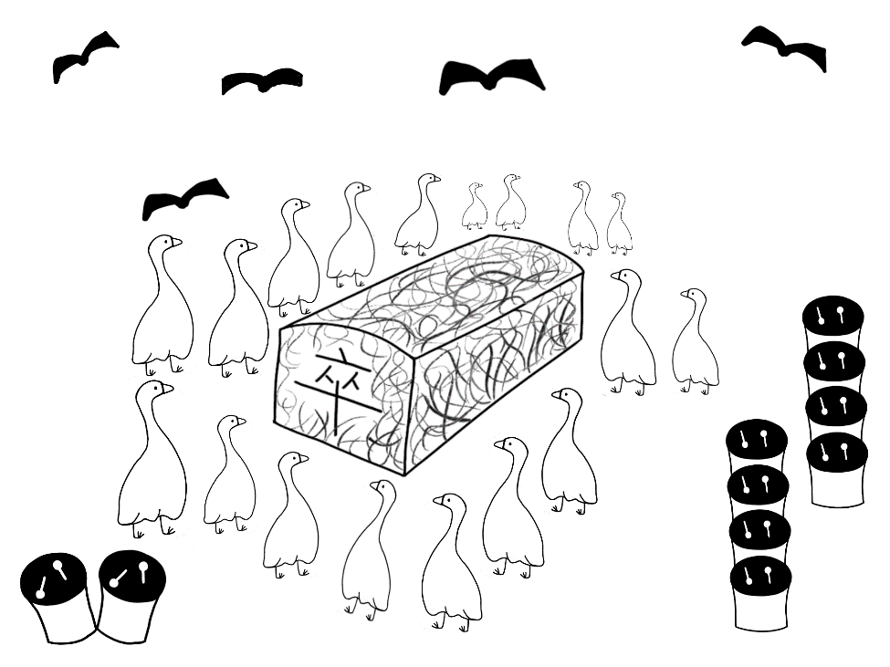
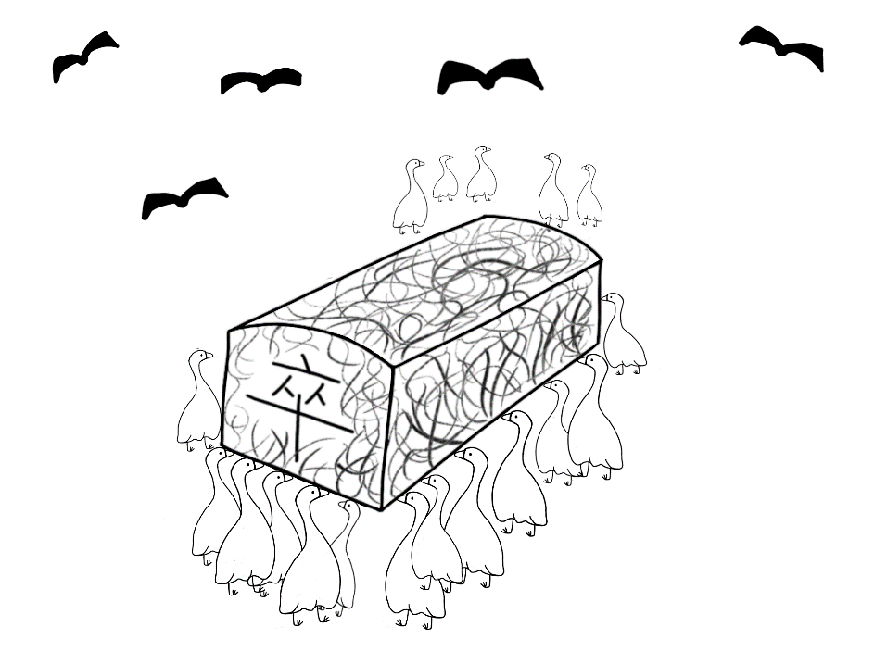
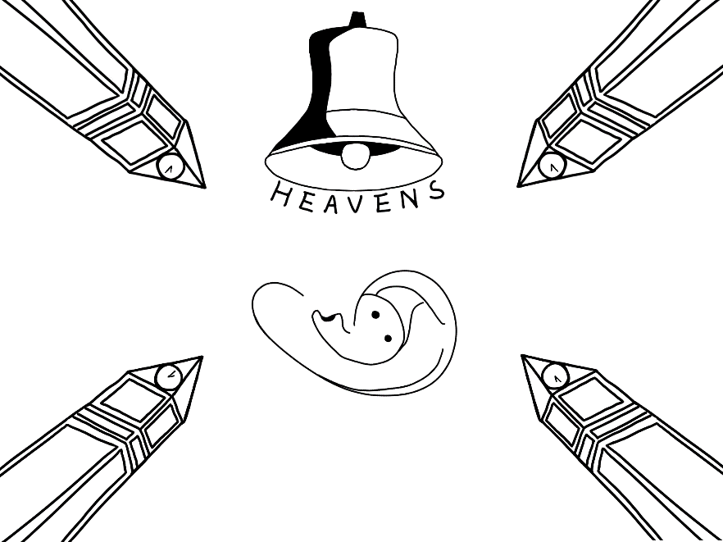
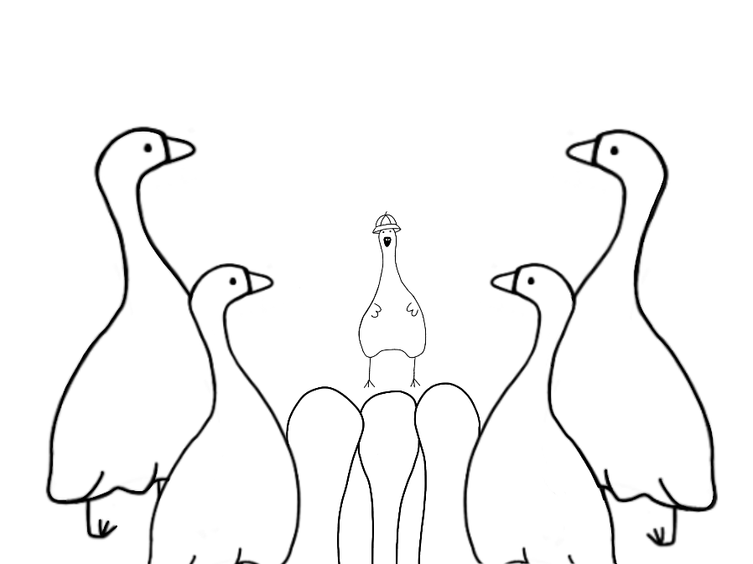
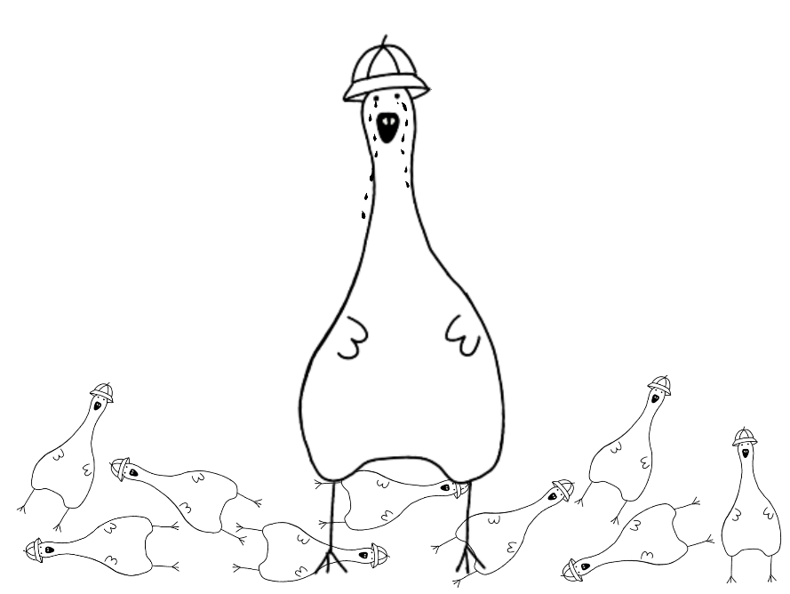
P
rototype

Slide 7
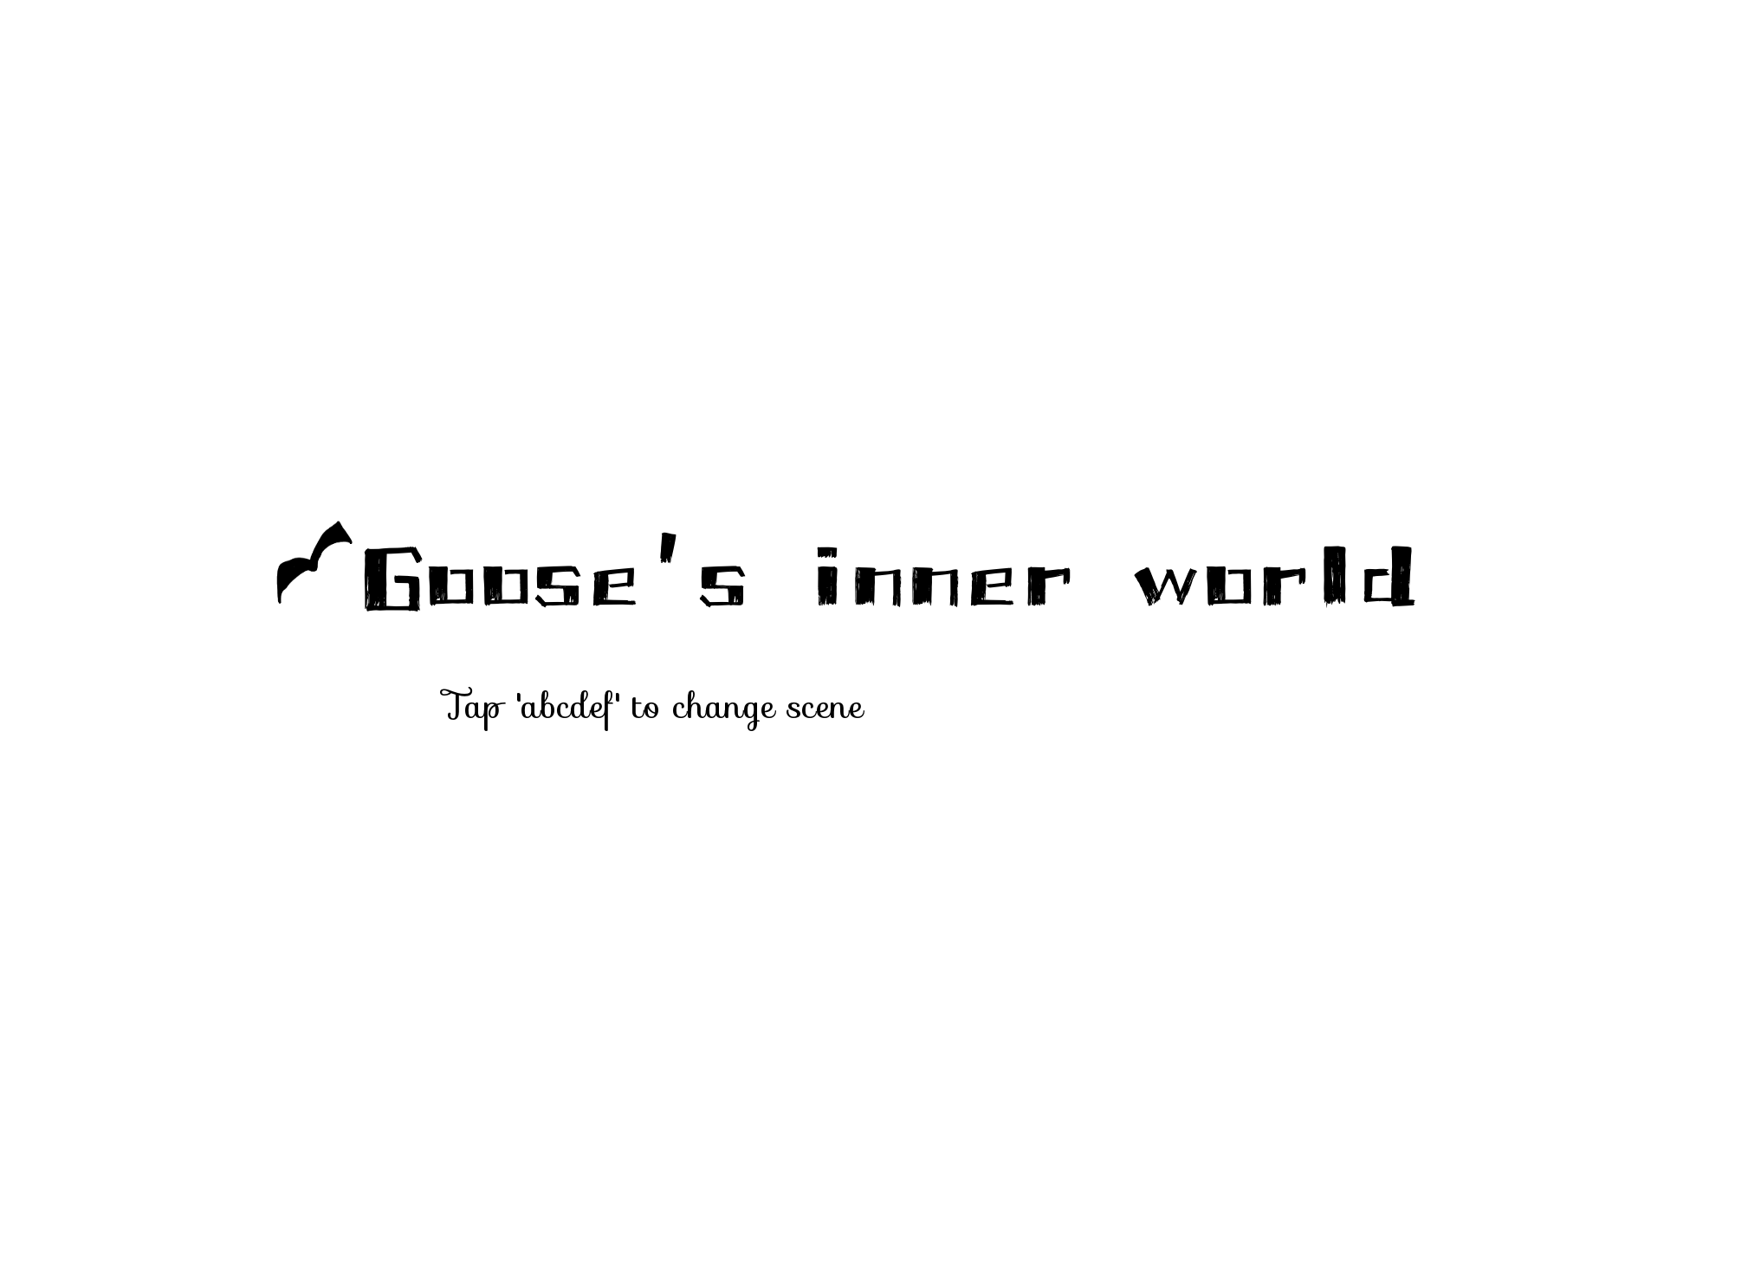
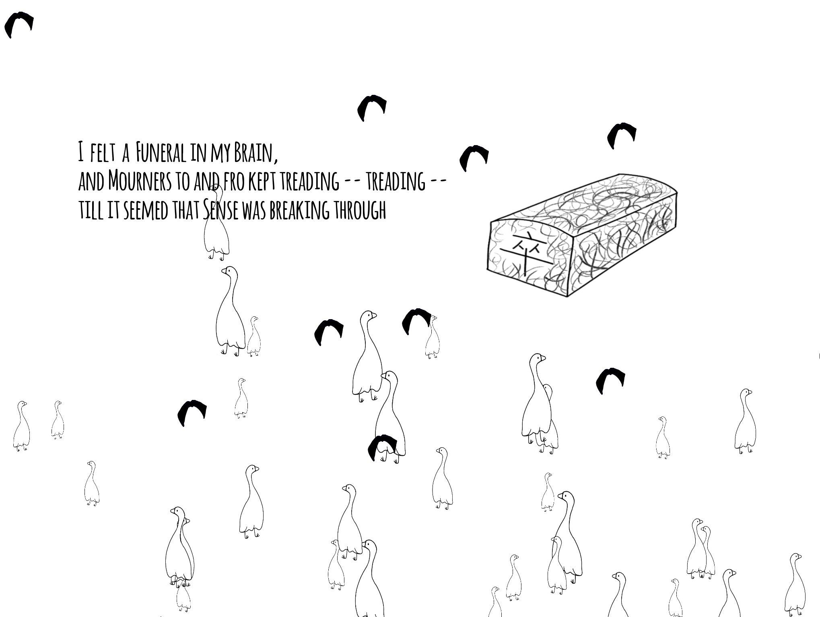
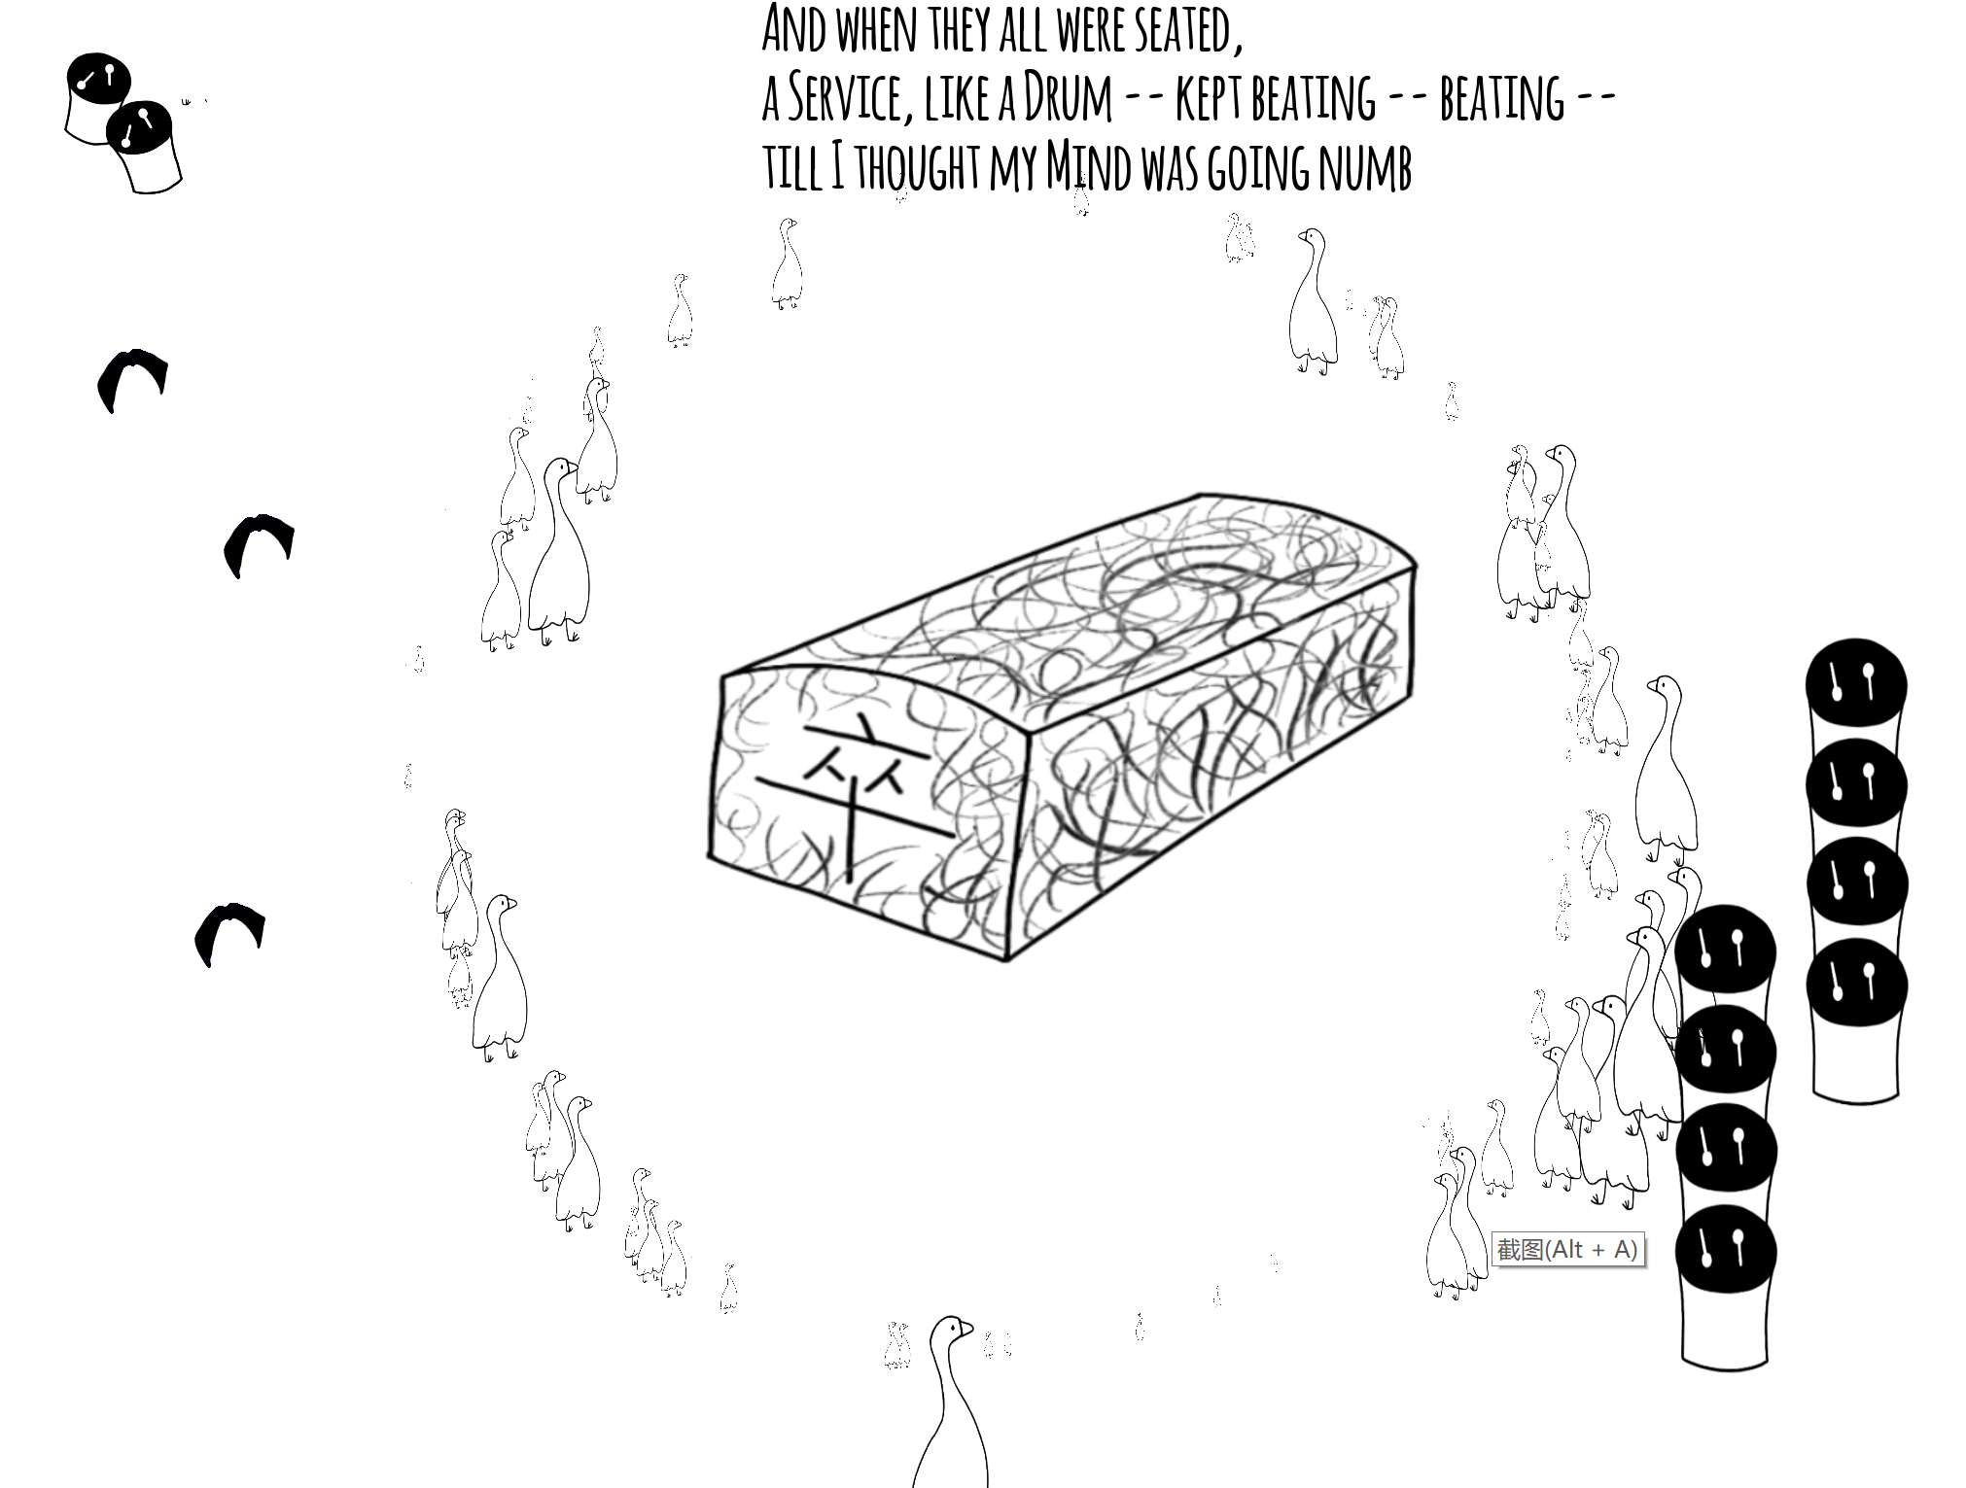
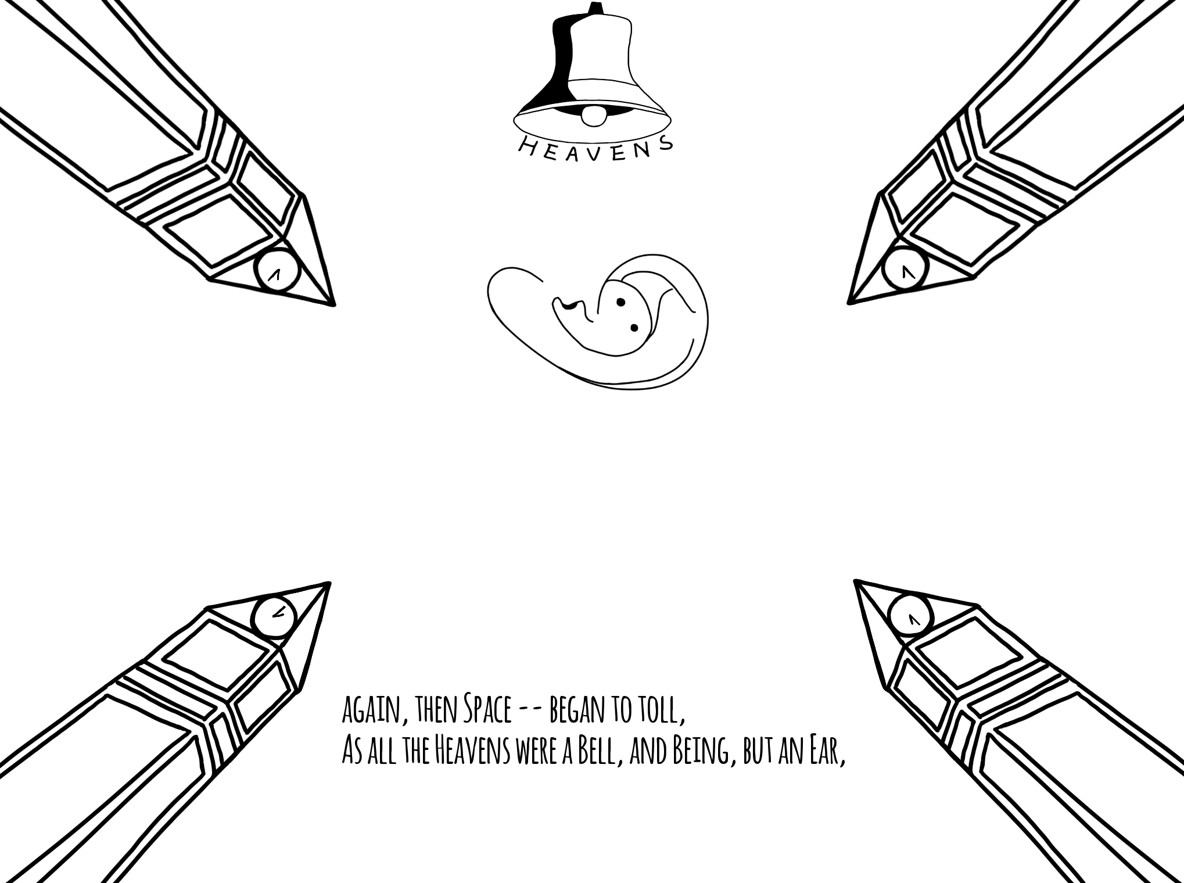
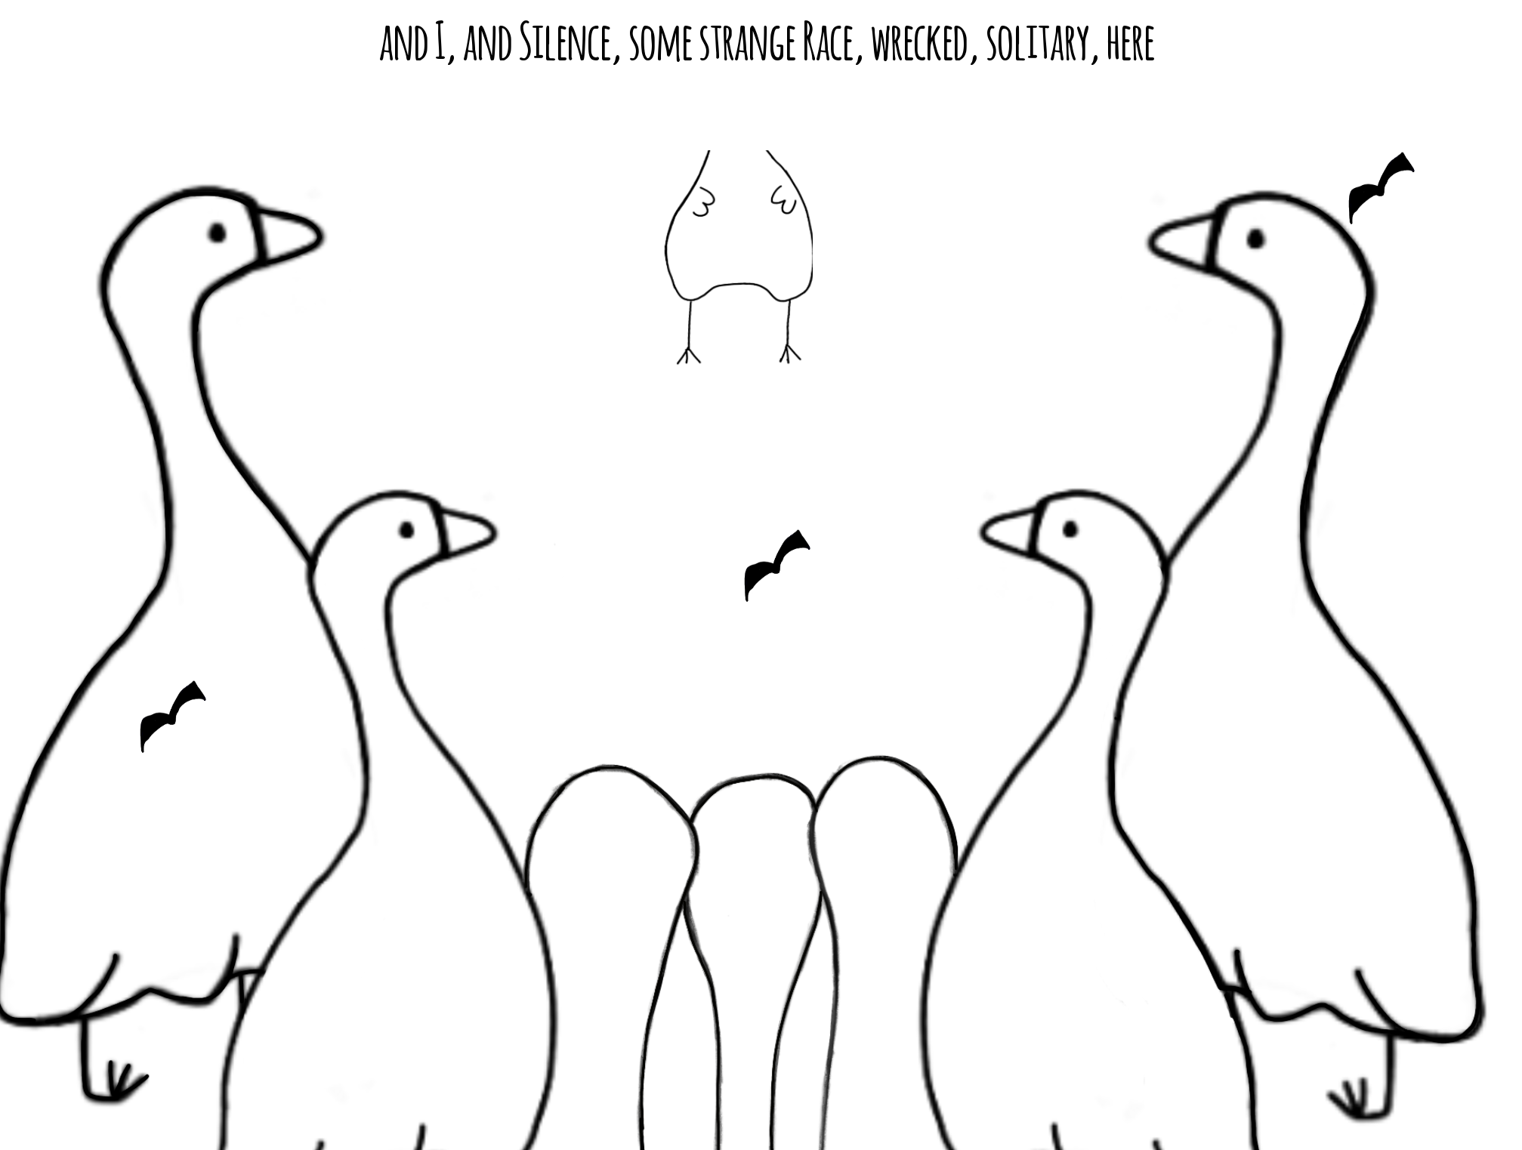
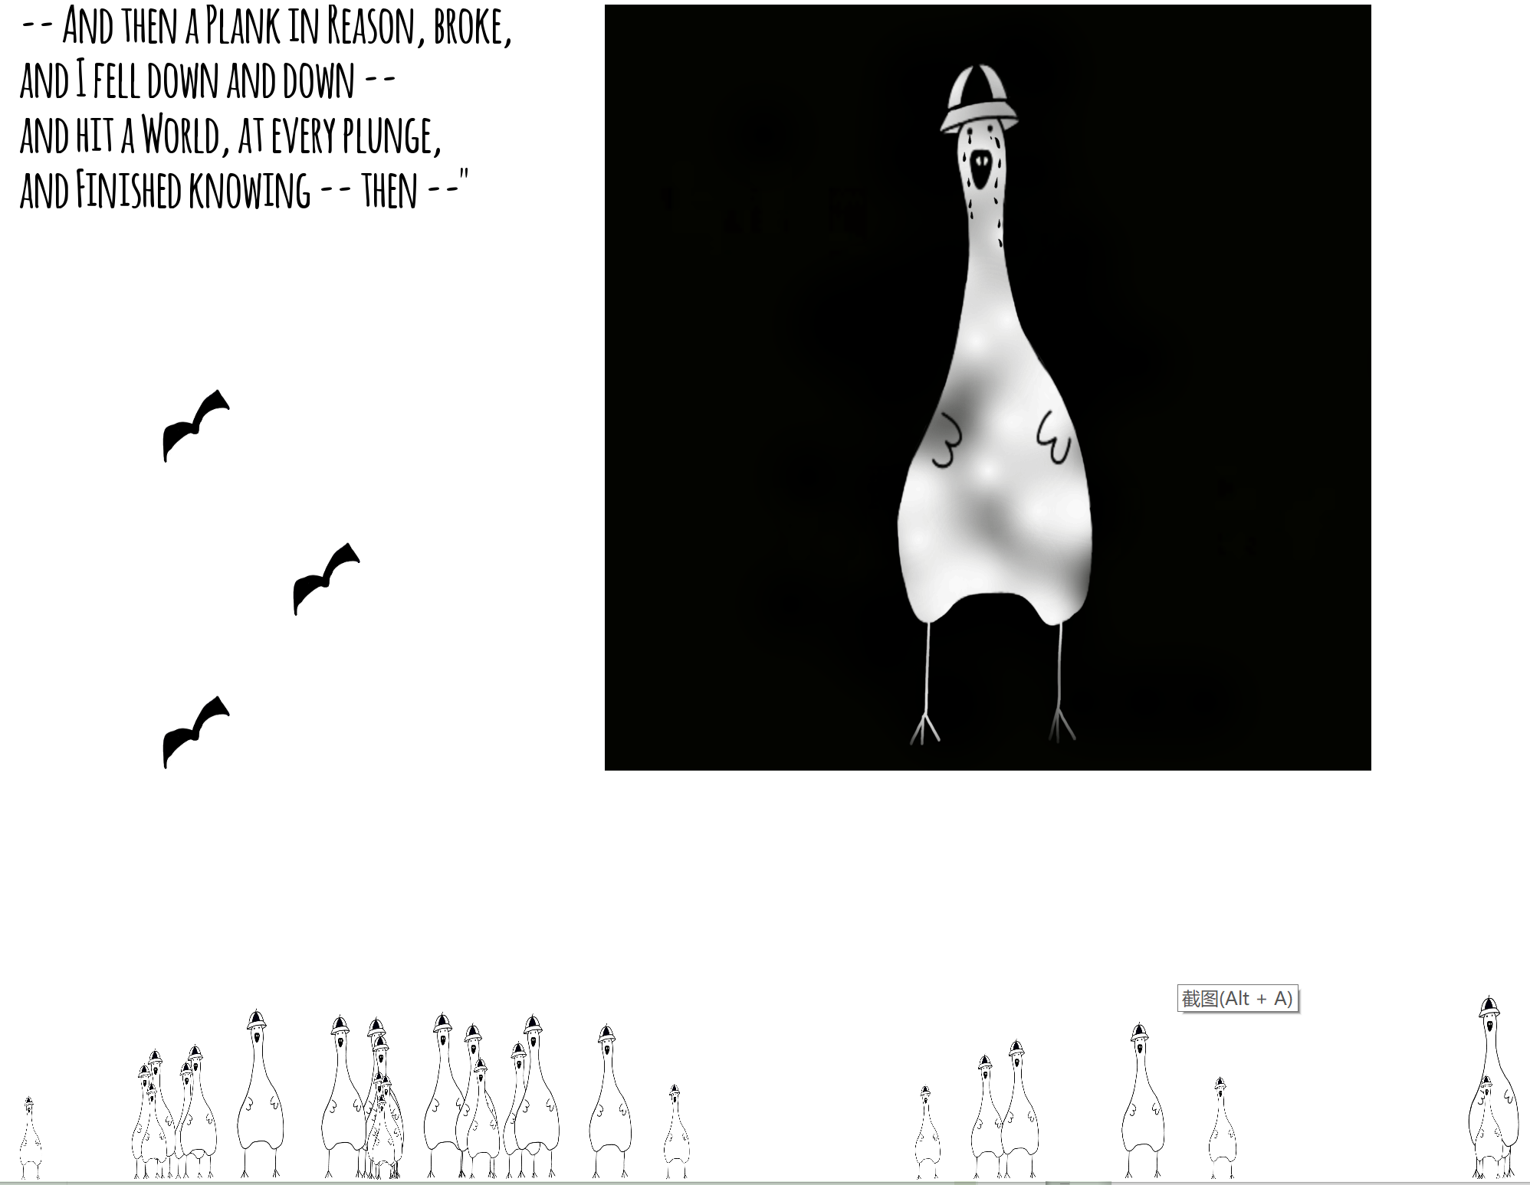

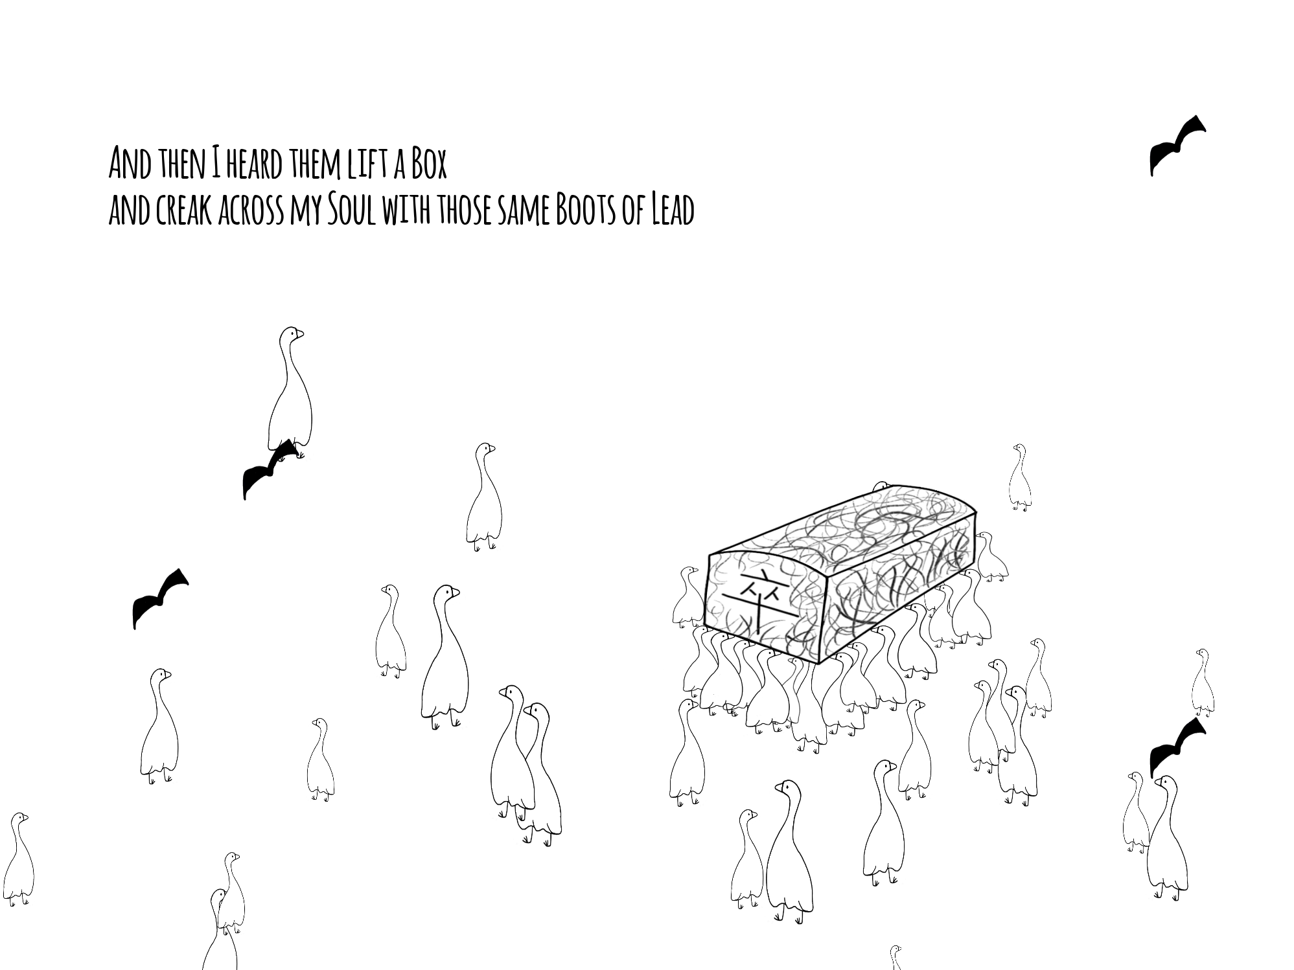
R
ealize

Slide 8
Q
&A
If you have any questions, feel free to ask me!

Slide 9
Thanks

